Slide 1




The social factor in European
semantic reusability
EU wide registry of public sector semantic models
SEMIC Pre-Conference Workshops
October 17, 2023

Slide 2
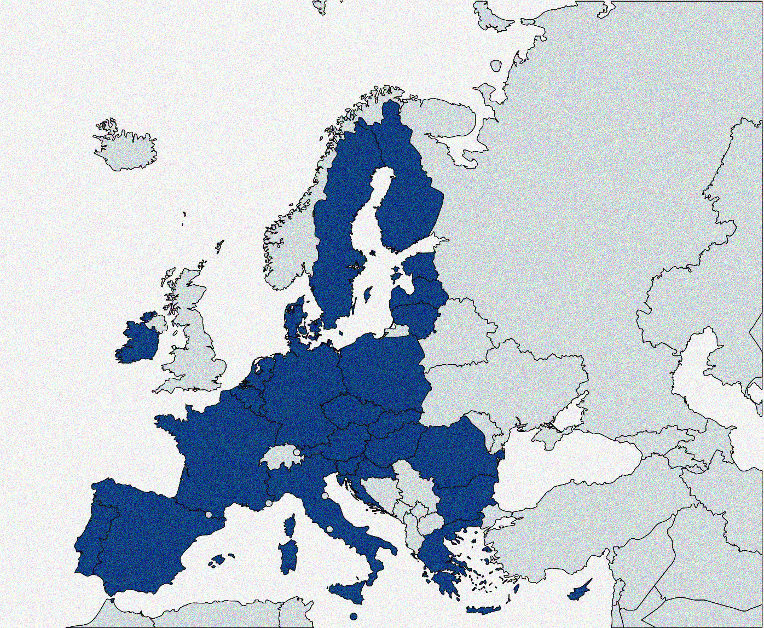
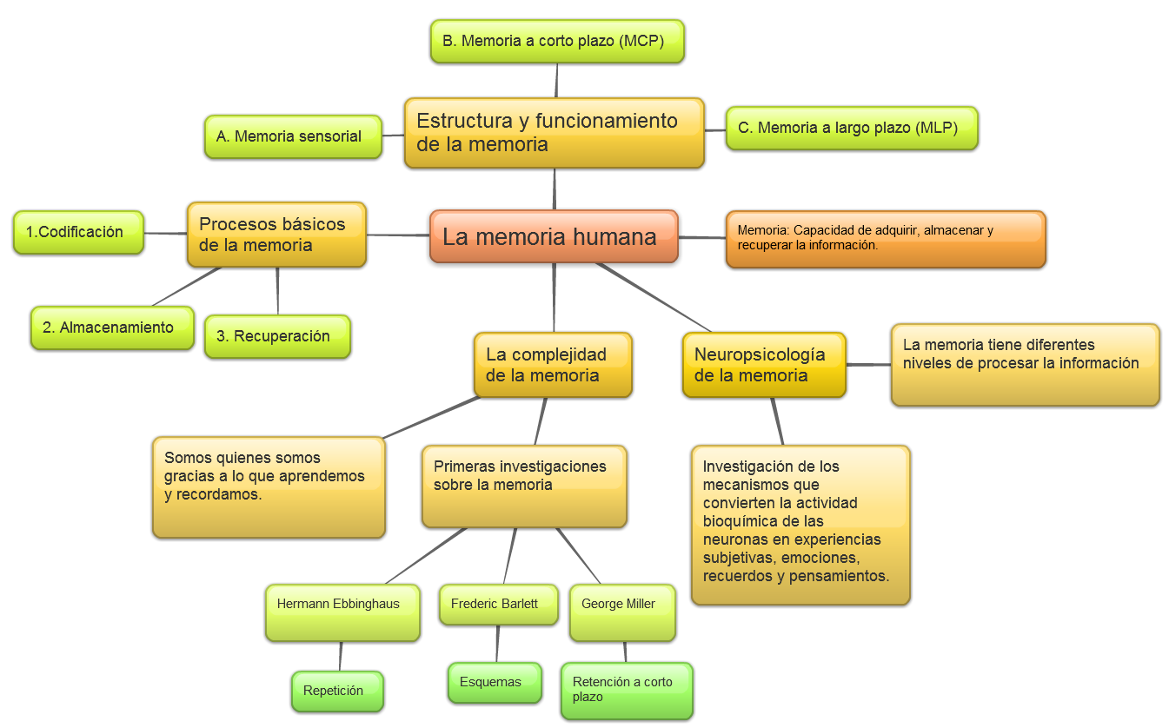

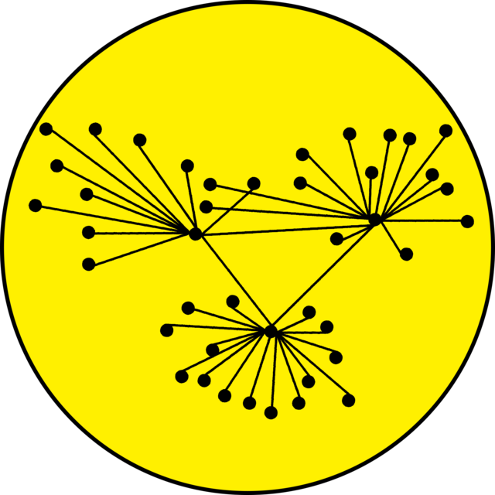







WHAT WE HAVE IN MIND: THE SEMANTIC EXPERT VISION
Semantic Reusability
Semantic Interoperability

Slide 3



WHAT IS THE SEMANTIC WORK ABOUT
Elicitation
Knowledge
Specification
Semantic requirements
Standardisation
Models
Storage
Semantic assets
Reuse
Artifacts for reusability
Socio-techical problem
The missing piece

Slide 4
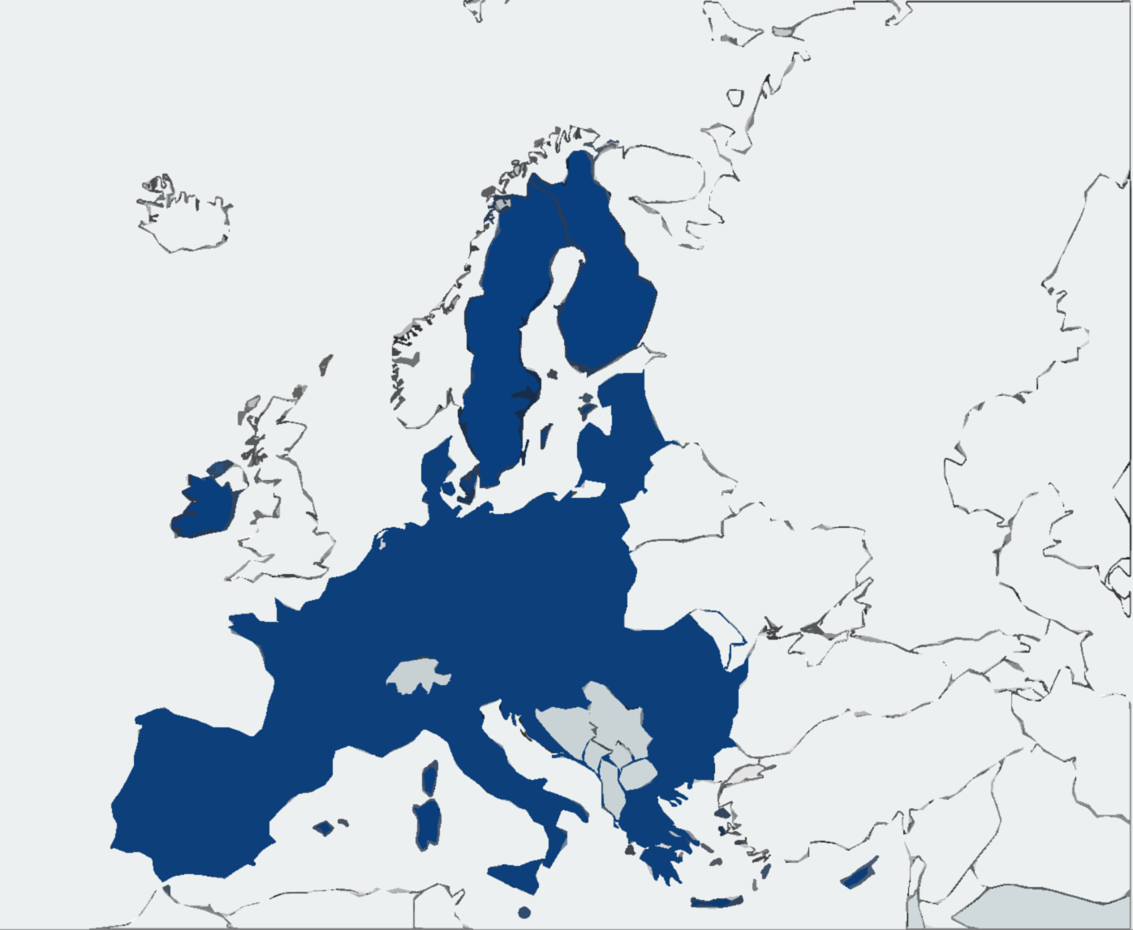
EXPERTS ON THE KNOWLEDGE DOMAIN OF PUBLIC SERVICES
Diversity of:
Languages & Concepts
Cultures & Legal frameworks
English as common language
Not native language (mostly)
Nuance issues
Accuracy issues
Bigger misunderstandings
Psych-sociological issues
Human biases
Elicitation issues
Onboarding and commitment issues
Little to no EU harmonisation of the knowledge domain
Experts on the national context
Laypeople in other contexts
Laypeople in semantics
New knowledge
Existing knowledge

Slide 5
FROM KNOWLEDGE TO FORMAL SPECIFICATION
EU-WIDE ELICITATION FRAMEWORK FOR THE PUBLIC SERVICE KNOWLEDGE DOMAIN
Methodology
Socio - technical
European - national
Agile – Structured
Collaboration – Traceability
Outcomes
Accuracy
Contextualisation
Versioning
Findability
Elicitation - Creation
Multilingualism

Slide 6
OBSTACLES IN DISCOVERY OF REUSABLE SEMANTIC ASSETS
Huge amount of assets
Asset scattering
Overlapping of concepts
Context/country-dependent meanings
Labels and descriptions in different languages
Lack of accuracy on meaning description
Lack of metadata at every level of an asset
Findability of proper semantic assets
Semantics as barrier for domain experts
Semantics as barrier for IT developers

Slide 7


ToDo FOR DISCOVERY OF REUSABLE SEMANTIC ASSETS
Multilingualism for labels and descriptions
Rich metadata for assets and their elements
ARTIFICIAL INTELLIGENCE
Metadata
Multilingualism
Linked-data
Guided machine learning
Generative IA
Code generation
Discovery
Reusability

Slide 8

Thank you for your attention
Human-centred technologies
Ana Rosa Guzmán <anarosa.guzman@correo.gob.es>
Secretariat-General for Digital Administration
State Secretariat for Digitalization and Artificial Intelligence
Ministry of Economic Affairs and Digital Transformation

